Slide 1
CPS LAB 3
The Sounds of English-IPA Symbols
Experiencing Public Speaking.
Impromptu speech.

Slide 2
IPA
International Phonetic Alphabet.
Each symbol represents a single sound.
We can transcribe any sound of any language with IPA.

Slide 3
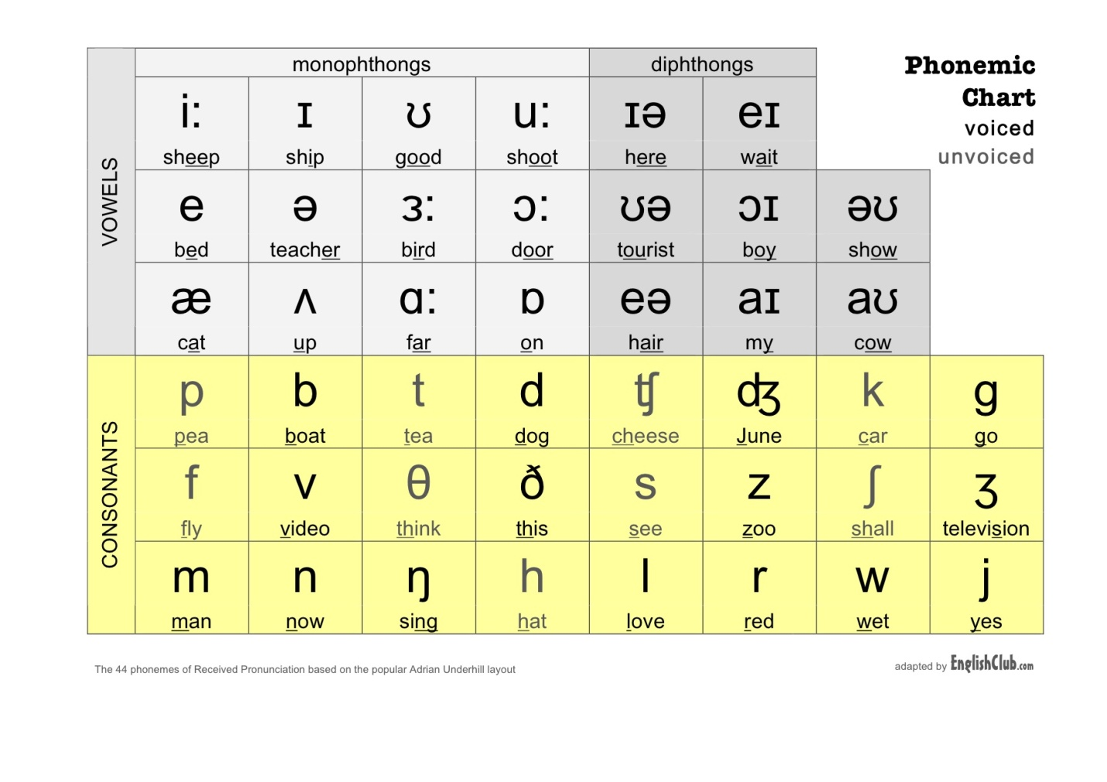
INTERNATIONAL PHONETIC ALPHABET AND THE SOUNDS OF ENGLISH
There are 44 sounds in English (12 vowels, 8 diphthongs, 24 consonant sounds) which are depicted in the chart below:

Slide 4
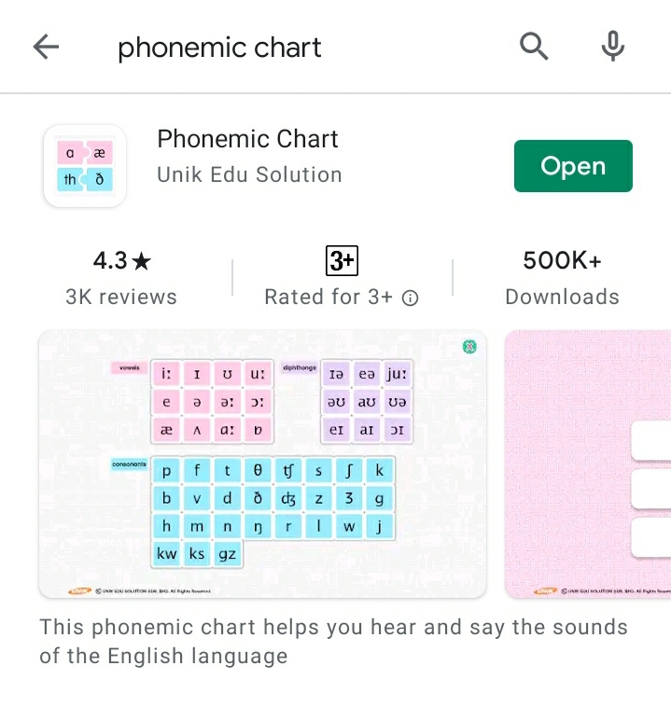
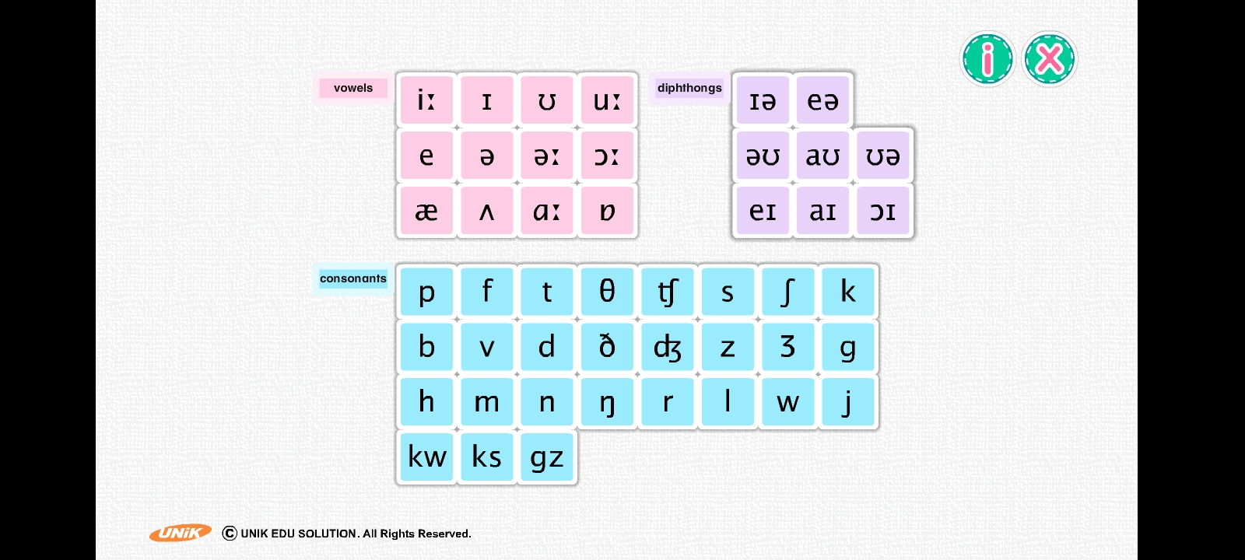
TASK: Download the following application from play-store and attempt the exercise.
USING THE APPLICATION, PRACTICE PRONOUNCING THE IPA SOUNDS.

Slide 6
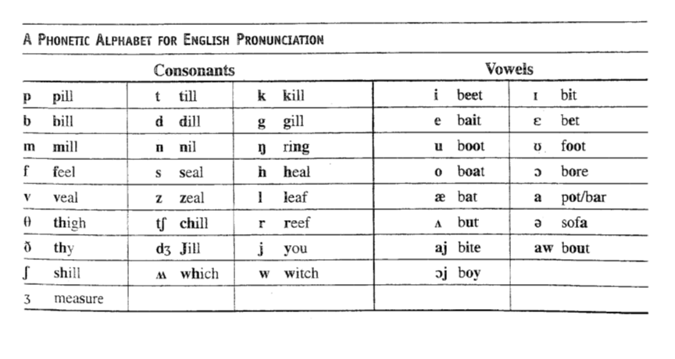
Vowels and consonants

Slide 7
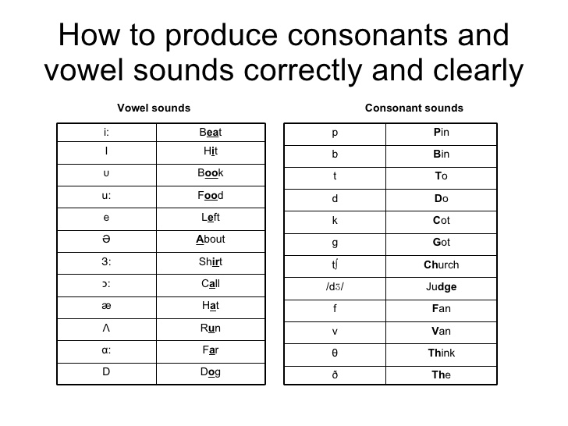
Vowels and consonants

Slide 8
Monophthongs vs. Diphthongs
Monophthongs
A single vowel sound is called a monotony.
In the this vowel sound, there is no appreciable change in quality (i.e. length) during a syllable, as in “father.”
Diphthongs
It literally means “having two sounds.” When there are two vowel sounds, there happen diphthongs i.e. “oil.”= “o”+ “I.”
There is a change in quality , as in “high.”

Slide 9
Diphthongs
a+I= /aɪ/ “high, buy,”
o+I= /ɔɪ/ “boy”
a+u= /aʊ/ “how”

Slide 10
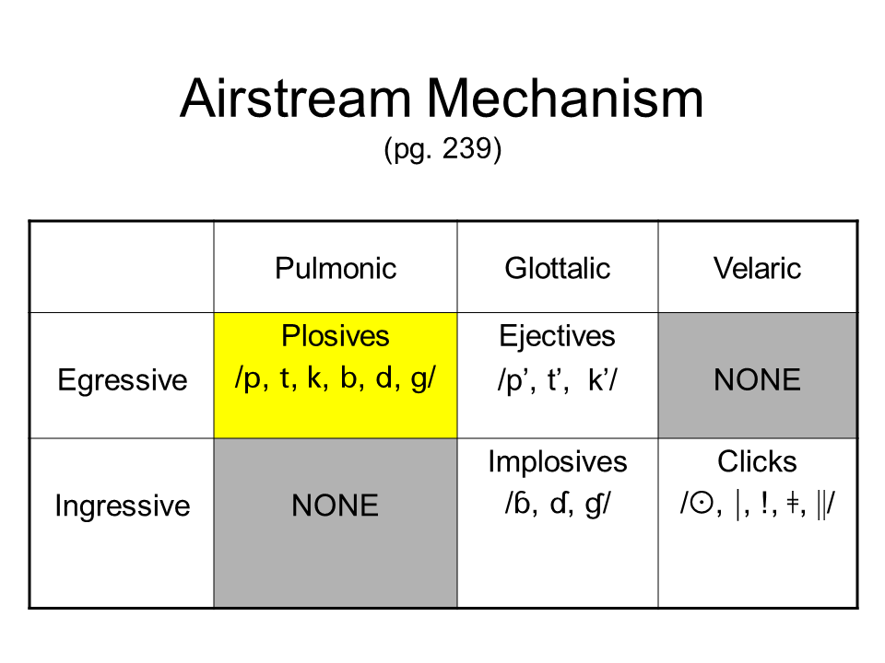

Slide 12
Stress placement
The symbol /ˈ / is a stress mark that has been placed before the syllable carrying the main stress.
Stress should always be marked in words of more than one syllable.

Slide 13
IPA SIGNS AND SYMBOLS:
Watch the video and make notes.
Pronunciation\International_Phonetic_Alphabet_(IPA)__English_Pronunciation(360p).mp4

Slide 14

Public speaking
A process, an act and an art of making a speech.

Slide 15
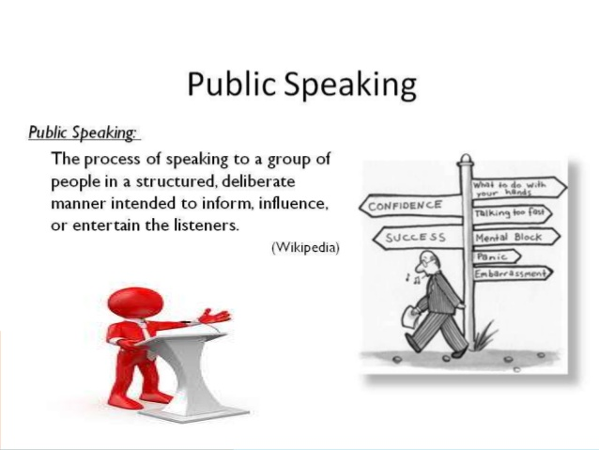
Definition.

Slide 16

Why is developing Public Speaking skills important?
Public Speaking
It is beneficial in many different areas.
Class projects
Job/internship presentations
Club/organization meetings or events
Speech at a family gathering such as a wedding, birthday, anniversary, etc.

Slide 17
Public speaking-history.
Public speaking evolved with the development of democracy in Athens.
It gave birth to sophism which lead to logical reasoning and argumentation in order to persuade people the.
Finally the art of rhetoric or oratory developed.

Slide 18
Three main types of public speaking
Speeches that inform:
Explain, report, describe, clarify, define and demonstrate. Such speeches can move an audience to action or belief. Their primary purpose is to present facts, details, and examples
2. Speeches that persuade
Are designed to convince and the goal is to influence the audience’s beliefs or attitudes.
This can be accomplished by using credibility, appeal to your audience’s emotions, reason, or sense of right and wrong
3. Speeches that entertain
use humor to influence. Once the audience is warmed up, one main idea is presented, still on a light note. Finally bring up the punch line.
Note: This is the most difficult of all presentations because it requires great ease and elegance and depends to a large degree on the charisma of the speaker.
to isolate and understand the primary purpose of your talk

Slide 19

Four basic methods of delivery
1. Reading a manuscript verbatim- A written speech is read out.
2. From memory- If you do have the ability to commit your entire speech to memory, you may do so. If you choose to speak without notes make certain you have the necessary delivery skills.
3. Speaking impromptu- With little or no preparation and without the use of notes.
Know what you’re talking about! Include experience. It automatically sounds natural and spontaneous.
Impromptu speaking follows three basic rules:
(a) Have something important to say; (b) Make your audience understand or believe it, and (c) Speak simply, directly and meaningfully.
Notes:
DELIVERING THE GOODS
There are four basic methods of delivering a speech: (1) reading a manuscript verbatim; (2) reciting a presentation from memory; (3) speaking impromptu; and (4) speaking extemporaneously.
1. Reading a manuscript verbatim. A manuscript that is read has several disadvantages. Unless the person who delivers the speech is extremely skilled the recitation will sound just as if it were read and it will likely have a sing-song tone to it. Reading a manuscript also fails to give the audience the eye contact necessary in order to keep attention. If you want to lose your audience entirely pursue this mode!
2. Reciting from memory. Daniel Webster, the famous author of Webster’s Dictionary could thrill audiences for three, four, or even five hours at a time. Even more incredible, he often spoke without using any notes which he attributed to his memory! Few people have Webster’s remarkable powers of memory. If you do have the ability to commit your entire speech to memory, you may do so. But one of the main disadvantages to memorizing an entire speech is that it creates too much pressure to get the speech “absolutely perfect.” Memorizing a speech can also result in a stilted, wooden sounding delivery.
Professional speakers who repeatedly deliver the same speech often commit it to memory, yet with each delivery they adjust the speech to suit the occasion and audience. Only a very skillful speaker can do this. The main disadvantage to memorization is what might happen if your attention was diverted and you could not recall what you were to say next. If you choose to speak without notes make certain you have the necessary delivery skills. You never get a second chance to give a speech.
Speaking impromptu. The impromptu speech is speaking at a gathering with little or no preparation and
without the use of notes. For many it might be likened to trial by fire, but it need not be that bad. Impromptu speaking follows three basic rules: (a) Have something important to say; (b) Make your audience understand or believe it, and (c) Speak simply, directly and meaningfully. Believe it or not, you already know how to speak off -the-cuff. You’ve been doing it for years since you go about your daily business without writing out what you are going to say. And you do just fine at it.

Slide 20
Four basic methods of delivery
4. Speaking extemporaneously-
Includes brief notes and is carefully prepared and practiced in advance. However, the exact wording is chosen at the time of delivery.
Advantages:
It gives the speaker more control over thought and language.
Offers greater spontaneity and directness.
It is adaptable to a wide range of situations.
It sounds spontaneous.
you are free to establish your ideas, can establish strong eye contact, gesture naturally, and concentrate on talking with your audience rather than speaking at them.
Notes:
DELIVERING THE GOODS
There are four basic methods of delivering a speech: (1) reading a manuscript verbatim; (2) reciting a presentation from memory; (3) speaking impromptu; and (4) speaking extemporaneously.
1. Reading a manuscript verbatim. A manuscript that is read has several disadvantages. Unless the person who delivers the speech is extremely skilled the recitation will sound just as if it were read and it will likely have a sing-song tone to it. Reading a manuscript also fails to give the audience the eye contact necessary in order to keep attention. If you want to lose your audience entirely pursue this mode!
2. Reciting from memory. Daniel Webster, the famous author of Webster’s Dictionary could thrill audiences for three, four, or even five hours at a time. Even more incredible, he often spoke without using any notes which he attributed to his memory! Few people have Webster’s remarkable powers of memory. If you do have the ability to commit your entire speech to memory, you may do so. But one of the main disadvantages to memorizing an entire speech is that it creates too much pressure to get the speech “absolutely perfect.” Memorizing a speech can also result in a stilted, wooden sounding delivery.
Professional speakers who repeatedly deliver the same speech often commit it to memory, yet with each delivery they adjust the speech to suit the occasion and audience. Only a very skillful speaker can do this. The main disadvantage to memorization is what might happen if your attention was diverted and you could not recall what you were to say next. If you choose to speak without notes make certain you have the necessary delivery skills. You never get a second chance to give a speech.
Speaking impromptu. The impromptu speech is speaking at a gathering with little or no preparation and
without the use of notes. For many it might be likened to trial by fire, but it need not be that bad. Impromptu speaking follows three basic rules: (a) Have something important to say; (b) Make your audience understand or believe it, and (c) Speak simply, directly and meaningfully. Believe it or not, you already know how to speak off -the-cuff. You’ve been doing it for years since you go about your daily business without writing out what you are going to say. And you do just fine at it.

Slide 21
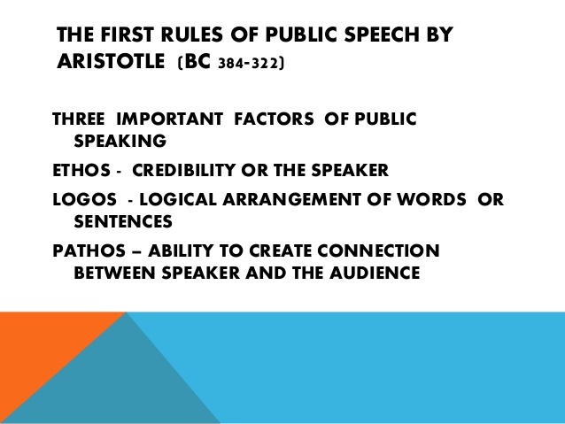

Slide 22
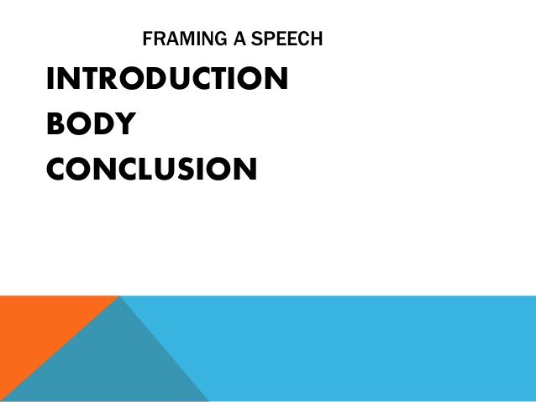

Slide 23
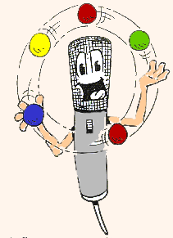
Three things you do during the intro.
Get attention
Startle the audience with an arresting statement/argument
Arouse curiosity
Notes:
There are three things to do at the very beginning:
(1) Get the attention of the audience. You can get attention and interest by relating the topic to the audience. People pay attention to things that affect them directly.
(2) Startle the audience with an arresting or intriguing statement. “Almost one year ago today, a perfect stranger saved my best friend’s life.”
(3) Arouse Curiosity. Give an arresting synopsis of what you will explore. Or you may question your audience. This draws the audience in immediately.
As important as the introduction is, keep it brief. While developing the body of your talk, be on the lookout for possible introductory materials. And be creative in devising your introduction, but don’t worry about the exact wording until you have finished preparing the body of your talk. After you have determined your main points, it will be much easier to make final decisions about how to begin your talk. Then practice the introduction over and over until you can deliver it smoothly from a minimum of notes and with strong eye contact.

Slide 24
Body.
Elaborate the subject
Give a division of the subject
Emphasize on the changes between the divisions
put relevant examples to support your stand

Slide 25
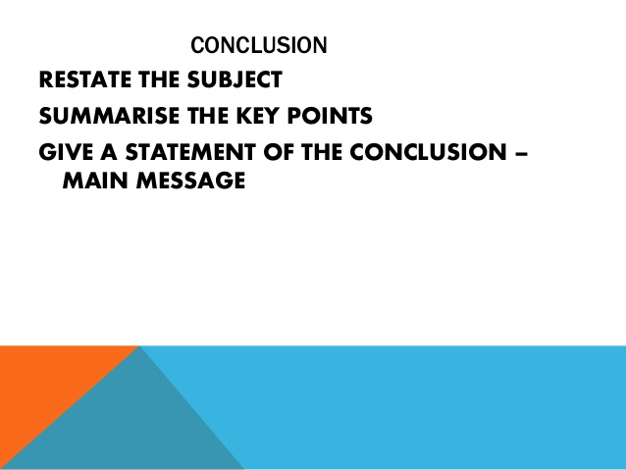

Slide 26
Elements of a Good Speech:
Attitude/posture : Position or posture of the body appropriate to or expressive of an action, emotion, etc.
Rehearsal
Vocal expression/voice tone and mood.
Nonverbal expression

Slide 27
Content
coherent
complete
correct
There are 7 C’s to consider:
clear
concise
Concrete
Courtesy
Tip:
Try to share one thing no one knows
Notes:
Here is an article with the 7 C’s of Communication in which this slide was adapted from:
http://www.mindtools.com/pages/article/newCS_85.htm
You can apply many of these principles of written communication into your public speaking content. It is often more difficult to perfect these 6 C’s when communicating verbally with a live audience instead of having time to write, review, re-write, re-review, and edit a written piece.
Write down the points you want to hit upon and any key phrasing/vocabulary you want to use and practice constructing these thoughts into sentences. Have someone else listen to your presentation and get feedback on the content. Are you explaining your message in the most effective way possible?

Slide 28
Rehearsal: Practice! Practice! Practice!
Check for facts and accuracy
Adapt remarks to occasion
Adapt remarks to audience
Create a sense of anticipation
Prepare speaking outline
Practice aloud
Polish & refine delivery
Present under similar conditions
Notes:
PRACTICE DELIVERY
You should practice all aspects of your delivery along with the words you plan to use. Start your practice sessions early so you will have plenty of time to gain confidence in your presentation. The following five steps may help:
1. Prepare your speaking outline. Make sure your speaking outline is easy to read at a glance. Keep it brief.
2. Practice your presentation aloud several times using only the speaking outline. Talk through all your stories and examples. If you plan on using visual aids, use them as you practice. Instead of trying to learn your talk word for word, concentrate on gaining control of the ideas. After a few tries you should be able to get through your talk with surprising ease.
3. Polish and refine your delivery. Practice your presentation in front of a mirror and check for eye contact and distracting mannerisms. Tape-record your message to gauge volume, pitch, rate, pauses―and vocal variety. Best of all, try your presentation out on your family or friends―or anyone who will listen. You need to know it goes over well with people.
4. Give your talk under conditions similar to those in the real thing. If you are presenting in a church, go to a church (during non―worship hours), and give the presentation aloud there. Regardless of where you hold your last practice session, you should leave it feeling confident and looking forward to the real event.
When in the early stages of planning public presentations, concentrate on such basics as speaking intelligibly, avoiding distracting mannerisms, and establishing eye contact with your listeners. Once you get these elements under control you can work on polishing your delivery in order to make a greater impact. Eventually you may be able to control the timing, rhythm, and momentum of a speech as skillfully as a conductor controls an orchestra.

Slide 29
Non-Verbal Communication
Positive Examples
Of Non-Verbal Communication
Negative Examples
Of Non-Verbal Communication
Head Looking Up
A Smile
Small Hand & Arm
Gestures
Free Arms
Keeping To One Area
Of The Stage
Making Eye Contact
With Various Members
Of The Audience
Head Looking Down
A Frown
Exaggerated Hand
& Arm Gestures
Folded Arms
Wondering About
The Stage
Only Focusing Your Eye
Contact On One Or Two
Members Of The Audience
Notes:
Read out and explain points from the slide.

Slide 30
Differentiate between public speaking and conversation
Public speaking is the process of speaking to a group of people in a structured, deliberate manner intended to inform, influence, or entertain the listeners.
Conversation is a form of interactive, spontaneous communication between two or more people who are following rules of etiquette.
There are three key differences that set public speaking apart from conversation: organizational structure, use of formalized language, and method of delivery.
Speeches involve thoughts that are logically organized and structured, whereas conversations may wander around subjects.
Speeches use formalized language, while conversation may use informal expressions and poor grammar.
Speeches are often delivered in deliberate, intentional settings and contexts, whereas conversations may arise spontaneously.

Slide 31
Do’s and Don’ts
Do:
Always repeat audience questions
Give audiences something to walk away with
Respect your audience’s time
Don’t:
make excuses
read your slides or verbatim from notes
defer answering questions
overload your slides
Notes:
Do:
-Repeat audience questions, this is especially important if you are in a large room where the rest of the audience did not hear or understand the question being asked. Repeating the question also confirms your understanding of the question to the person asked you the question.
-Give the audiences something to walk away with. What can audiences walk away from your presentation knowing or feeling that they did not know or feel before. What immediate actions do you want them to take?
-Respect your audiences’ time, if you are asked to present for an hour go for 50 minutes, a thirty minute presentation should go for 25 minutes. This allows time for your audience to ask questions as well as insures that you are not stealing time from your audience members. **This is especially true if you are presenting at a conference and your audience needs to get to another presentation, lunch, or home.
Don’t:
-Don’t make excuses, don’t tell your audience that: you just put this presentation together, you didn’t have time to prepare, or that you’re not good at presenting. Have confidence in yourself, the quality of your hard work, and in your abilities.
-Don’t read from your slides, if you can help it don’t even look at your slides. The slides are there to help your audience follow along, not to tell you what to say. Don’t read from your notes, your audience is able to read, but they are attending your presentation to listen to you, don’t read to them.
-If an audience member asks a question that fits well into where you are in your presentation, be sure to answer their question immediately. If they are jumping ahead, you should feel comfortable jumping ahead, answering their question, and then going back and continuing where you left off. The thought behind this philosophy is that you do not want to stifle or hinder any engagement from your audience. If you don’t know the answer to a specific question, thats fine, let them know that you will get back to them and be sure to follow through on your promise to do so.
-Your slides are to act as a visual aid to your audience. Don’t let your visual aid be a visual distraction. Your slides should be simple, easy to follow, and complement your presentation.

Slide 32
TASK: On the given topics, prepare an impromptu speech.
Remember the following three basic rules:
. Have something important to say
. Make your audience understand or believe it.
. Speak simply, directly and meaningfully.
Have:
Introduction
Boy
conclusion

Slide 33
Topics:
How I perceive myself?
My biggest concern for the future is...
Real wealth is never measured in money or possessions.
Conservation is survival.
The more we communicate, the less we really say.
Real love is not the stuff of pop songs.
If I were an animal I'd be a...
Laughter is the best medicine.
Beauty is always in the eye of the beholder.
Poverty is a state of mind.

Slide 34
Assignment 1 for C.L.O. 1 Small Talk
Work in your groups.
Find any topic and setting. Prepare a mall talk of no more than 5 minutes. Submit the written script with your roll numbers mentioned. Record the small talk and upload it in the folder for your section on google classroom. Any 1 member from the group shall upload it.
Last date for submission. March 2nd, 2021.

